Slide 1


Thresholding Boolean co-abundance analysis for continuous valued datasets
Student : Devi Chandran
Supervisor : Jens Christian Claussen
Student ID : 2430977

Slide 2
PROJECT DEMONSTRATION

Slide 3
OUTLINE

Slide 4
PROBLEM
Continuous generalization of ESABO method
Thresholding for continuous valued datasets
Application of ESABO method to a plant abundance dataset
Extract the correlations in the data
Feature selection and extraction of important interactions
Find the mutualistic and competitive interactions
Find the major species driving the system

Slide 5
BACKGROUND

Slide 6
Boolean co-abundance analysis
Binarization or Thresholding to abundance data
Application of Boolean Operations(here, AND operation) to a combination of two species
Association analysis
Clustering and Visualisation : Generation of graphs and networks for the analysis of structure

Slide 7
Entropy Shifts of Abundance vectors under Boolean operations(ESABO Method)
Entropy shifts are used to identify key species that are responsible for driving changes in community structure
Particularly beneficial for the analysis of low abundance segments due to the usage of only binary abundance vectors
Information content/Entropy of pairs of abundance vectors when combined with Boolean operations

Slide 8
Boolean data(0-absent, 1- present) → Columns: samples, Row: species
b_{i} and b_{j} abundance vectors of two species
b_{i} AND b_{j}
Entropy calculation of resulting vector
Calculation of random permutations of b_{j} → b_{j}*and calculation of b_{i} AND b_{j}*
Creation of a null model of entropy distribution by randomly permuting for R = 1000 times
Calculation of z-score: (H(x_ij_AND) - μ)/σ

Slide 9
Modified ESABO method
No generation of random permutations of b_{j}
z- number of ones in b_{i} AND b_{j} (x_{ij}^{AND})
For each z in [Max(0, n + m − N_{A}), Min(n, m)], we calculate w(z).
Inputs:
n( number of ones in b_{i})
m (number of ones in b_{j}),
N_{A}( number of samples)

Slide 10
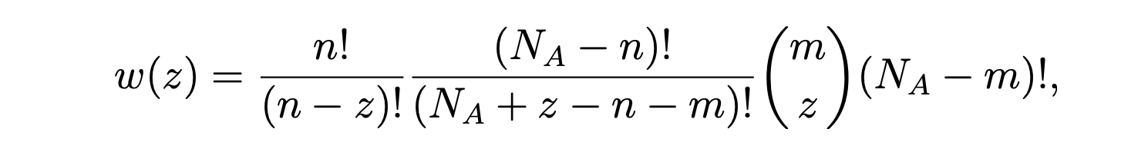
w(z) – calculates the number of permutations with z number of ones:
Inputs:
n( number of ones in b_{i})
m (number of ones in b_{j}),
N_{A}( number of samples)

Slide 11
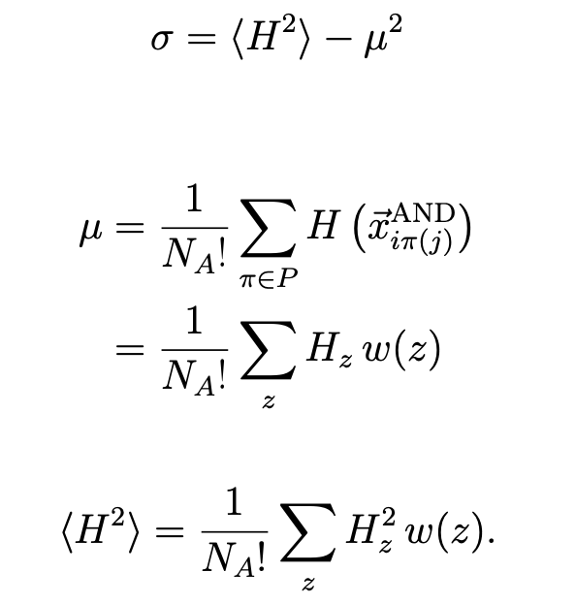

Slide 12
Finding optimal threshold for the data
Maximal information gain
Z-score is the shift in entropy compared to randomly reshuffled vectors
Iterating across different threshold values
Summation of z-scores for each threshold

Slide 13
Motivation and major objectives
Calculate the optimal threshold value for the dataset
Find the major species interactions in the human microbiome dataset
Identify key species in the ecosystem
Finding the network of microbial interactions

Slide 14

Methodology
Application of ESABO and modified ESABO method to data using a sample threshold value
Finding out the high and low abundance segments in the data using relative abundance
Separately thresholding the high and low abundance segments
Using the modified ESABO method to find the networks in the data
Analysing the networks created using network complexity measures

Slide 15

Dataset 1: Microbiome abundance dataset
16s rRNA sequencing dataset
OTU(Operational Taxonomic Unit)--> Classify and group microorganisms based on their genetic similarity
The Inflammatory Bowel Disease Multi'omics Database(IBDMDB) under the Human Microbiome Project-https://ibdmdb.org
Notes:
16S rRNA gene is found in the genomes of all bacteria -> conserved and variable regions(differentiate between species)
Extract DNA
16S rRNA gene is found in the genomes of all bacteria -> conserved and variable regions(differentiate between species)
Extract DNA and amplify the 16S gene using polymerase chain reaction(PCR), sequencing amplified DNA, resulting sequences are then clustered into OTUs
frequency of each unique sequence in the sample

Slide 16

Dataset 2: Plant abundance dataset
A scientific study to establish the impacts and benefits of stock grazing in National Parks.
The study took place in selected River Red Gum, Black Box and Cypress pine reserves in the Riverina, Central West and Western NSW(New South Wales).
https://datasets.seed.nsw.gov.au/dataset/nsw-grazing-studyd114

Slide 17
Data Preprocessing
Modified the data
Selected useful information from the dataset such as the plant species and its corresponding sites
Creation of pivot table

Slide 18

RESULTS

Slide 19
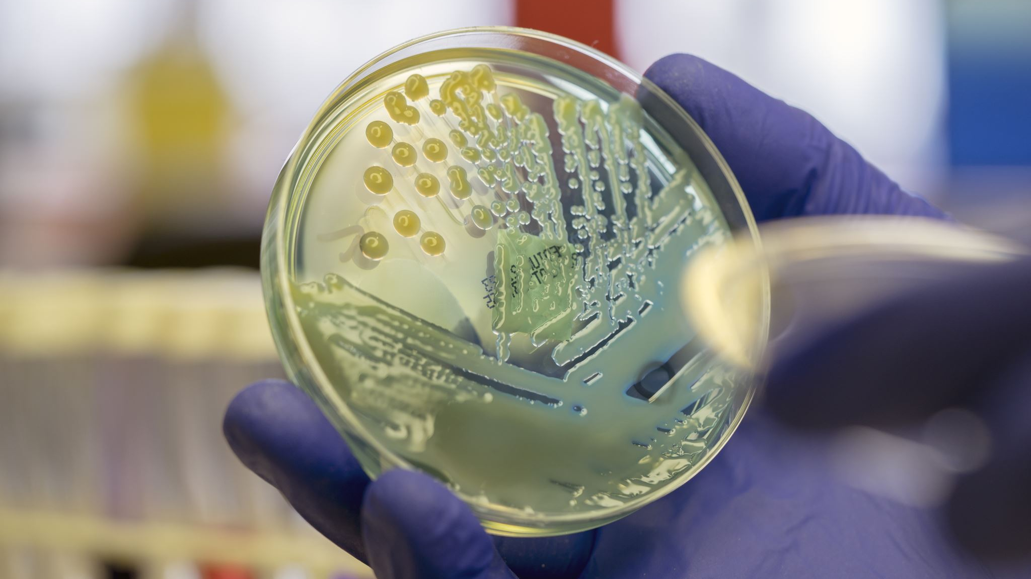
MICROBIOME DATASET

Slide 20
MICROBIOME DATASET
Finding the highly abundant and lowly abundant microbiomes using their relative abundance
Finding optimal threshold value for highly abundant microbiomes

Slide 21
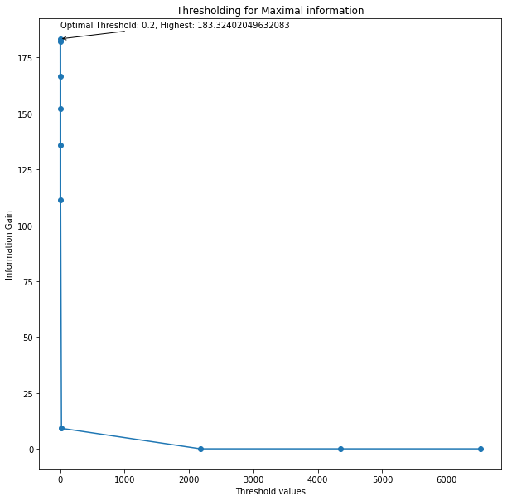
HIGHLY ABUNDANT MICROBIOMES
Optimal threshold value : 0.2
Maximum information gain obtained : 183.324

Slide 22
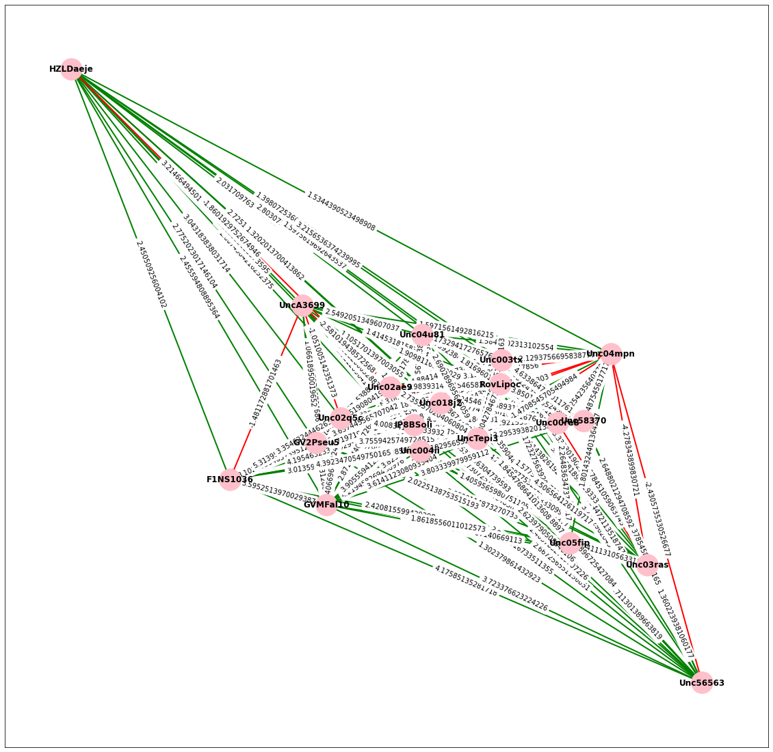
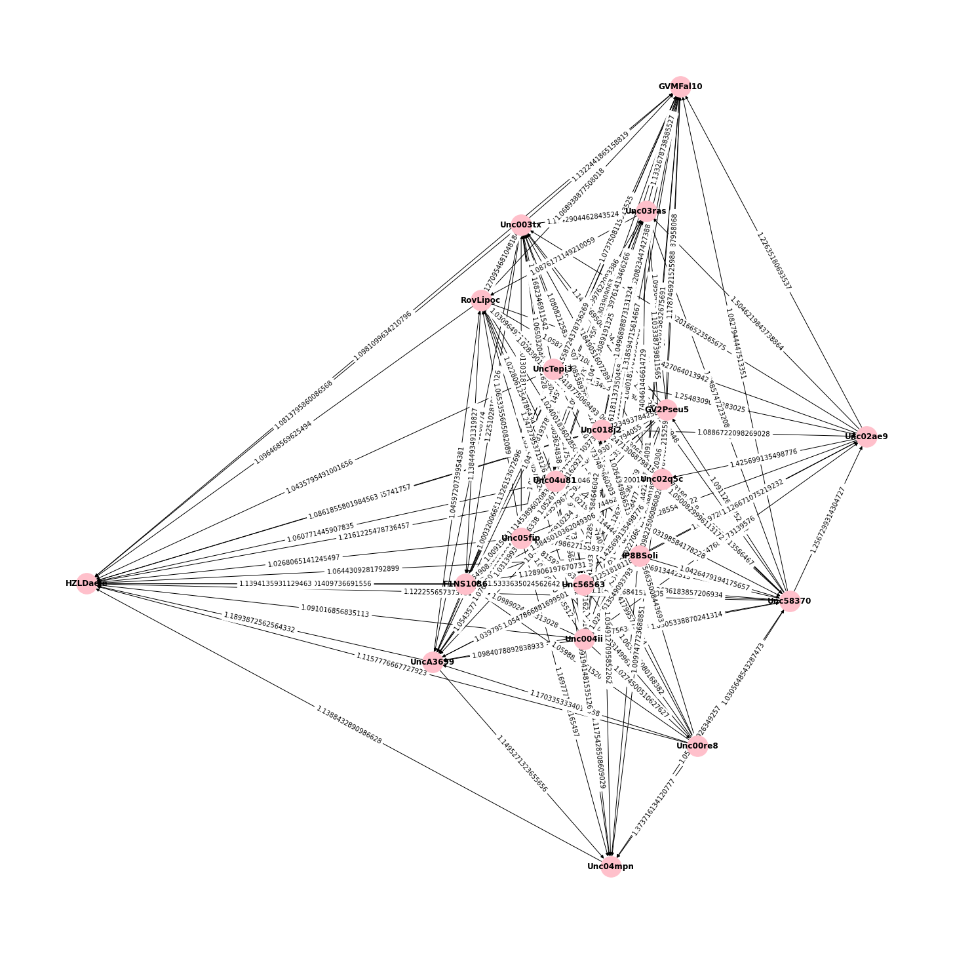
Highly abundant microbiome network(Using optimal threshold value of 0.2)
Using ESABO
Using modified ESABO

Slide 23
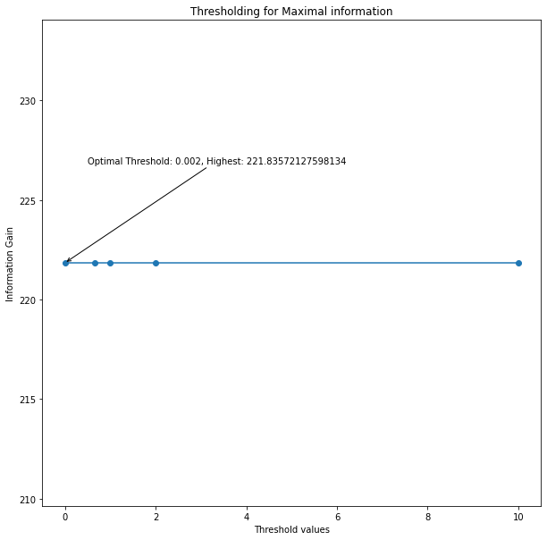
LOWLY ABUNDANT MICROBIOMES
Optimal threshold value : 1
Maximum information gain obtained : 221.8357

Slide 24
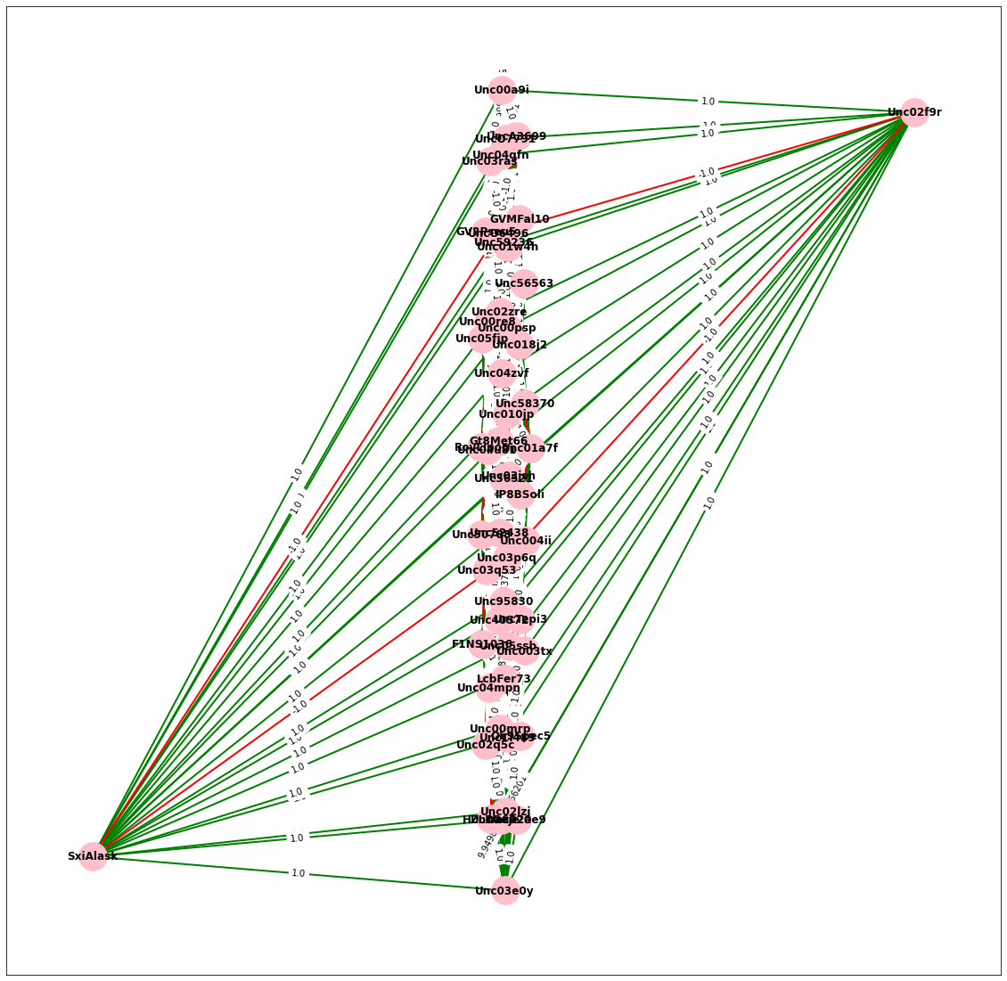
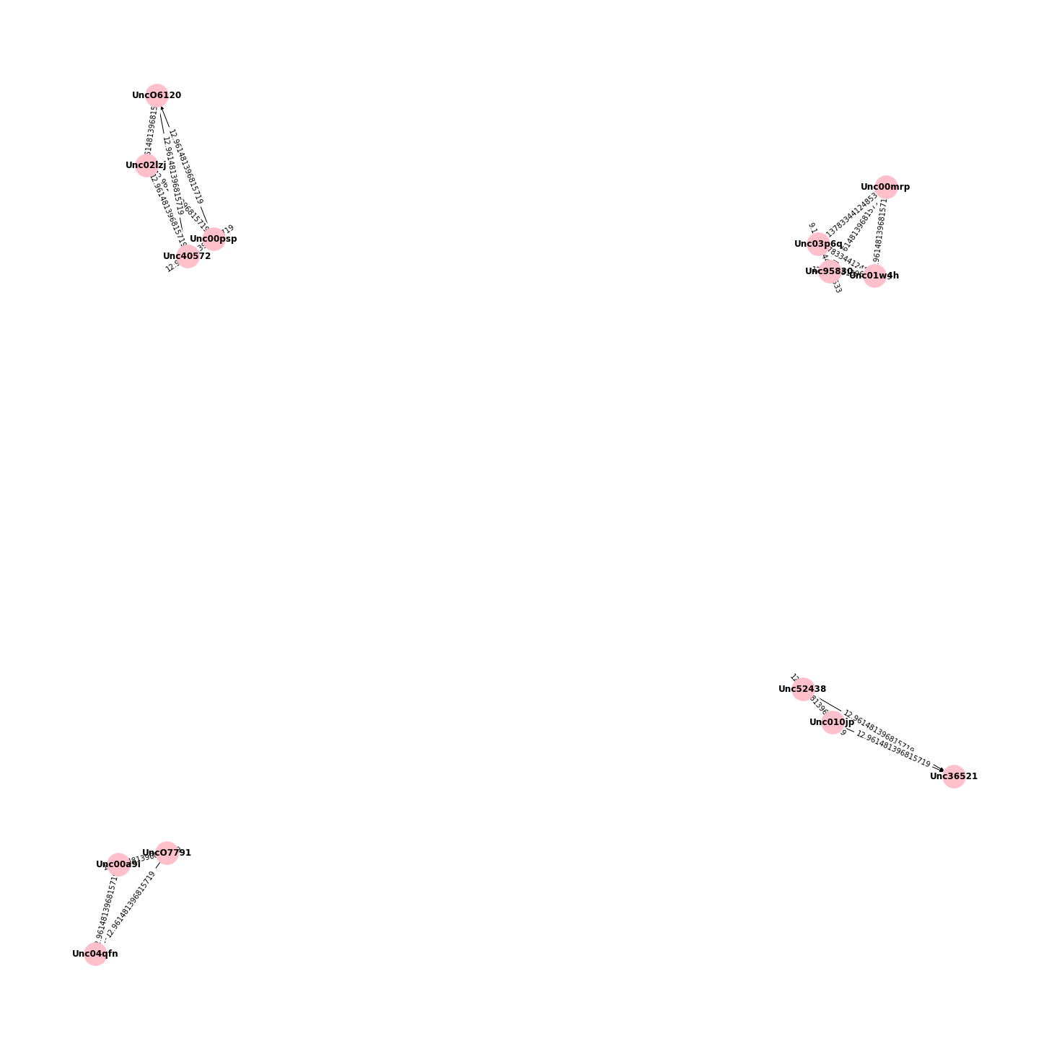
Lowly abundant microbiome network(Using optimal threshold value of 1)
Using ESABO
Using modified ESABO

Slide 25

PLANT SPECIES ABUNDANCE DATASET

Slide 26
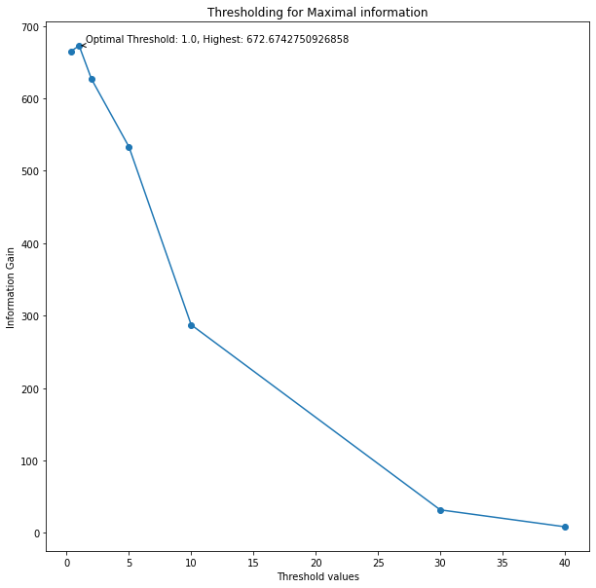
HIGHLY ABUNDANT PLANTS
Optimal threshold value : 1
Maximum information gain obtained : 672.6742

Slide 27
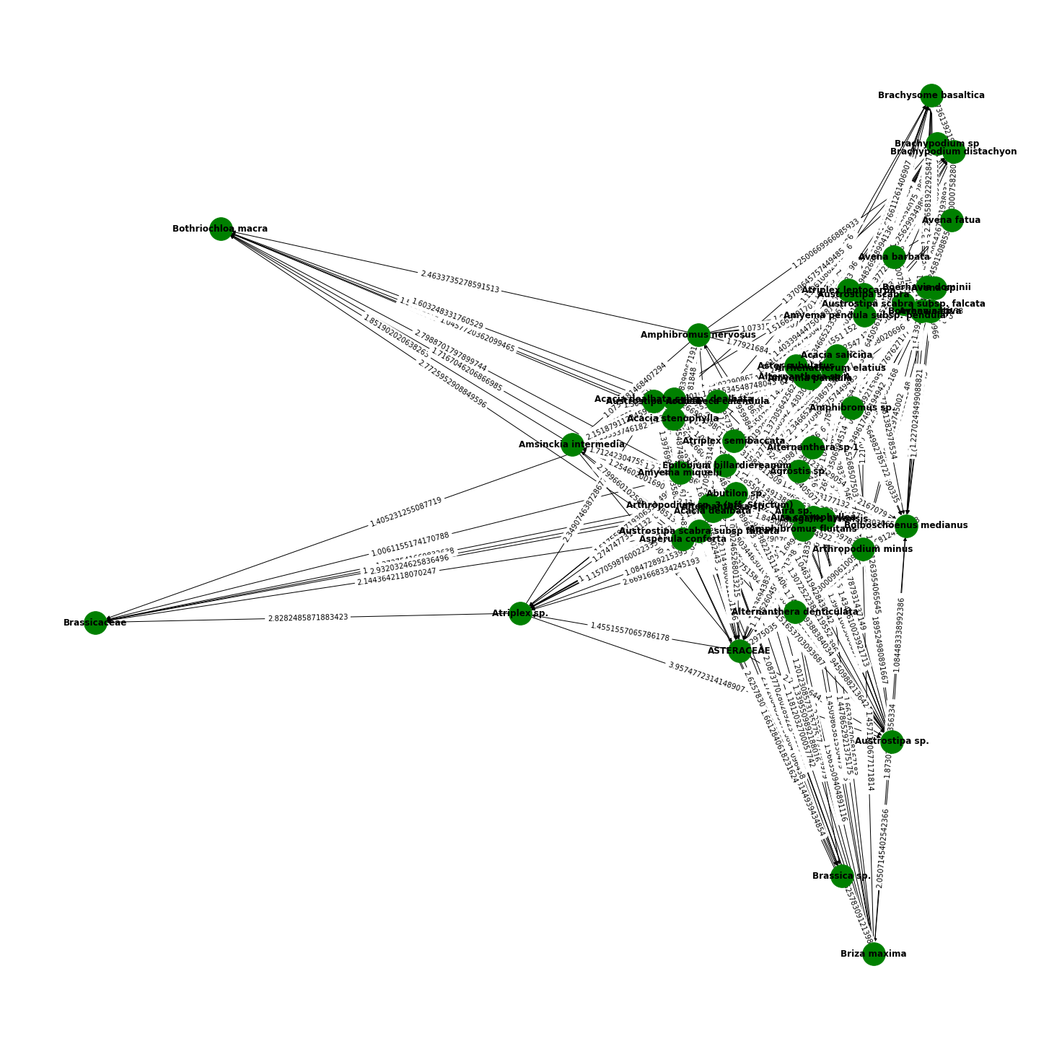
Highly abundant plant network(Using optimal threshold value of 1)

Slide 28
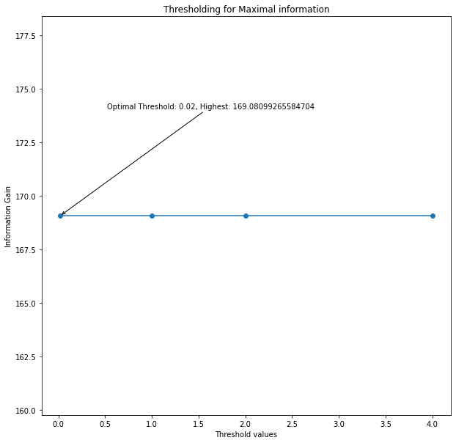
LOWLY ABUNDANT PLANTS
Optimal threshold value : 1(Constant information gain throughout)
Maximum information gain obtained : 169.08099

Slide 29
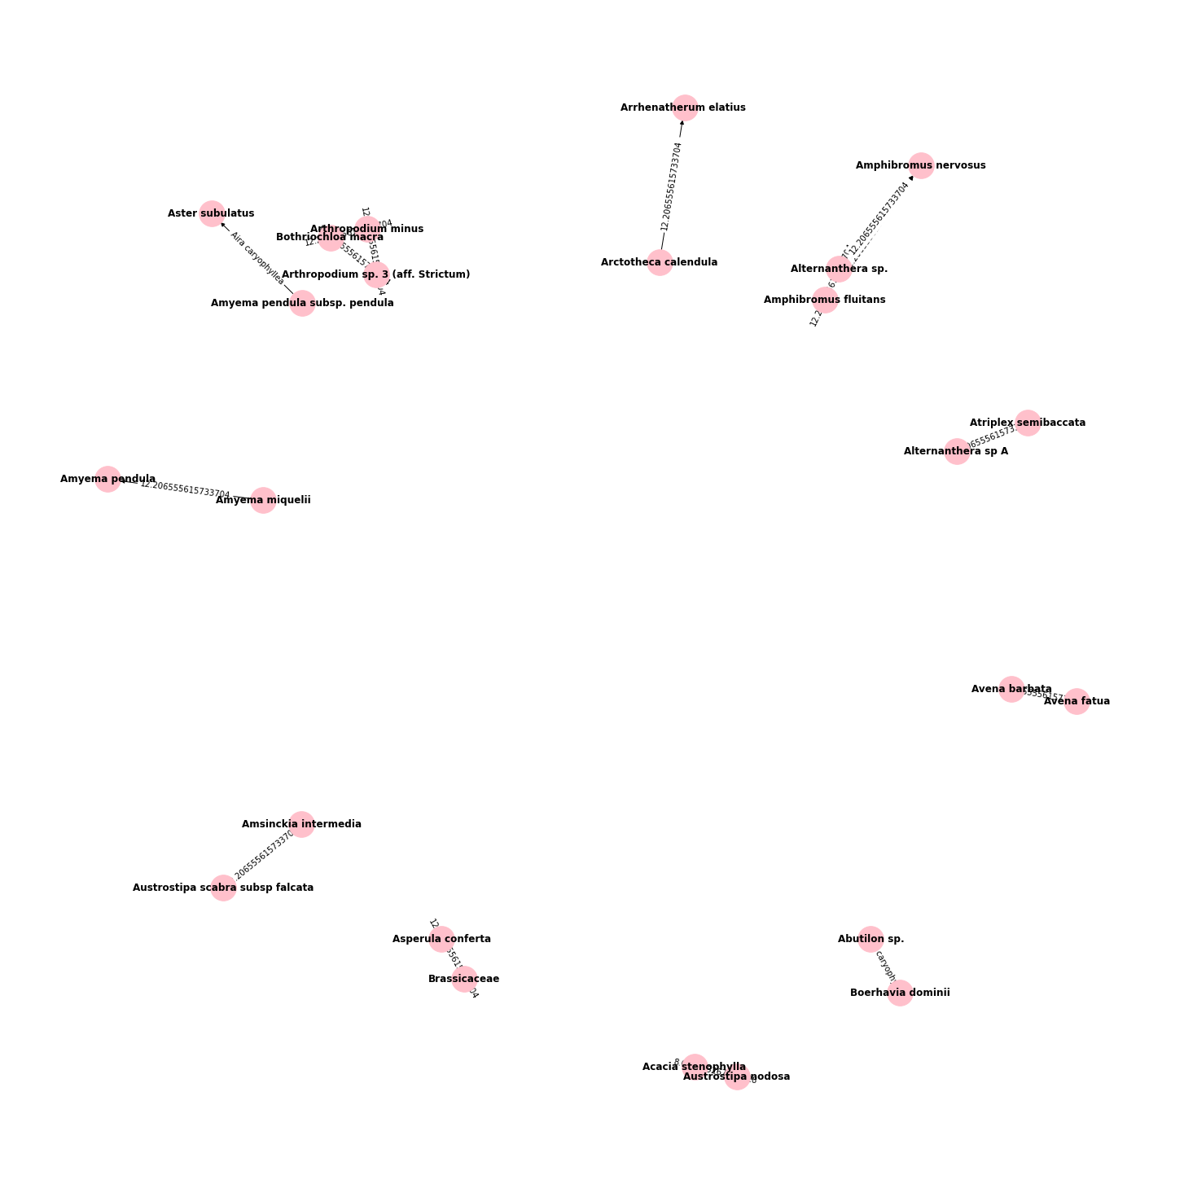
Lowly abundant plant network(Using optimal threshold value of 1)

Slide 30

NETWORK ANALYSIS

Slide 31

Edge Density
Edge Density (D) = (Number of Edges) / (Total Possible Edges)
Interpretation: A higher edge density indicates a denser and more interconnected network, while a lower edge density suggests a sparser network.

Slide 32

Average Degree Density
Formula: Average Degree = (Total Number of Edges) / (Total Number of Nodes)
Interpretation: Networks with a high average degree have nodes with many connections, while those with a low average degree have nodes with fewer connections.

Slide 33

Average Clustering Coefficient:
Formula: Average Clustering Coefficient = (Σ(Clustering Coefficient of All Nodes)) / (Total Number of Nodes)
Interpretation: A high average clustering coefficient indicates that nodes in the network tend to form tightly-knit groups or clusters, while a low value suggests a more decentralized or random structure.

Slide 34
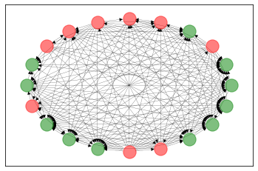
HIGHLY ABUNDANT MICROBIOME NETWORK
LABELS | VALUES
EDGE DENSITY | 0.43157894736842106
AVERAGE DEGREE DENSITY | 16.4
AVERAGE CLUSTERING COEFFIECIENT | 0.4521979469618788
NO. OF COMMUNITIES | 2
COMMUNITIES | ['F1NS1036', 'GV2Pseu5', 'GVMFal10', 'HZLDaeje', 'RovLipoc', 'Unc003tx', 'Unc02q5c', 'Unc03ras', 'Unc04mpn', 'Unc56563', 'UncA3699’] ['IP8BSoli', 'Unc004ii', 'Unc00re8', 'Unc018j2', 'Unc02ae9', 'Unc04u81', 'Unc05fip', 'Unc58370', 'UncTepi3']

Slide 35
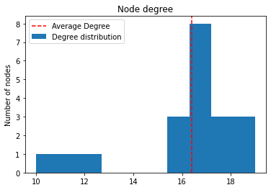
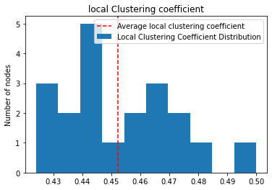
Degree distribution
Local clustering coefficient distribution

Slide 36
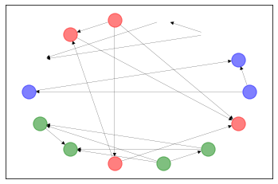
LOWLY ABUNDANT MICROBIOME NETWORK
LABELS | VALUES
EDGE DENSITY | 0.0989010989010989
AVERAGE DEGREE DENSITY | 2.5714285714285716
AVERAGE CLUSTERING COEFFIECIENT | 0.4521979469618788
NO. OF COMMUNITIES | 4
COMMUNITIES | ['Unc00mrp', 'Unc01w4h', 'Unc03p6q', 'Unc95830’] ['Unc00psp', 'Unc02lzj', 'Unc40572', 'UncO6120’] ['Unc010jp', 'Unc36521', 'Unc52438’] ['Unc00a9i', 'Unc04qfn', 'UncO7791']

Slide 37
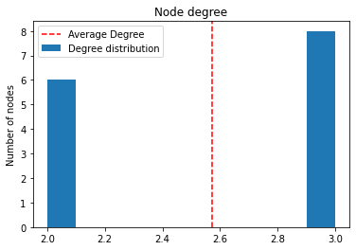
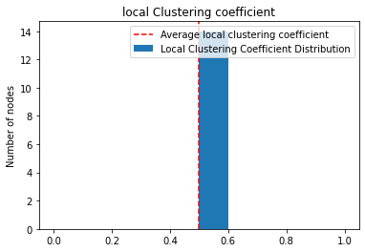
Degree distribution
Local clustering coefficient distribution

Slide 38
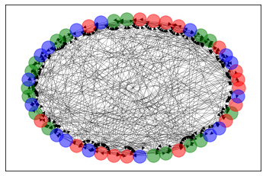
HIGHLY ABUNDANT PLANT NETWORK
LABELS | VALUES
EDGE DENSITY | 0.16857142857142857
AVERAGE DEGREE DENSITY | 16.52
AVERAGE CLUSTERING COEFFIECIENT | 0.2699667326561256
NO. OF COMMUNITIES | 3
COMMUNITIES | [' Epilobium billardiereanum', 'Acacia salicina', 'Amyema pendula', 'Amyema pendula subsp. pendula', 'Arctotheca calendula', 'Arrhenatherum elatius ', 'Arthropodium minus', 'Austrostipa scabra', 'Austrostipa scabra subsp falcata', 'Austrostipa scabra subsp. falcata', 'Avena sativa', 'Avena sp.', 'Boerhavia dominii', 'Boerhavia sp.', 'Bolboschoenus medianus', 'Brachypodium distachyon', 'Brachysome basaltica’] ['Abutilon sp.', 'Agrostis sp.', 'Aira caryophyllea', 'Alternanthera sp 1', 'Alternanthera sp A', 'Alternanthera sp.', 'Amphibromus fluitans', 'Amphibromus sp.', 'Arthropodium sp. 3 (aff. Strictum)', 'Aster subulatus', 'Atriplex leptocarpa', 'Atriplex semibaccata', 'Atriplex sp.', 'Austrostipa sp.', 'Avena barbata', 'Brachypodium sp', 'Brassicaceae’] ['ASTERACEAE', 'Acacia dealbata', 'Acacia dealbata subsp. dealbata', 'Acacia stenophylla', 'Aira sp.', 'Alternanthera denticulata', 'Amphibromus nervosus', 'Amsinckia intermedia', 'Amyema miquelii', 'Anagallis arvensis', 'Asperula conferta', 'Austrostipa nodosa', 'Avena fatua', 'Bothriochloa macra', 'Brassica sp.', 'Briza maxima']

Slide 39
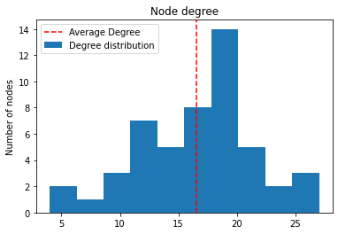
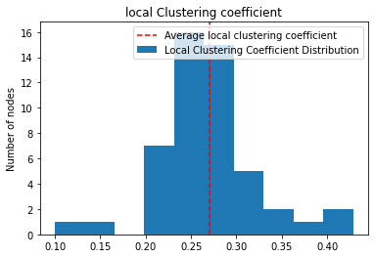
Degree distribution
Local clustering coefficient distribution

Slide 40
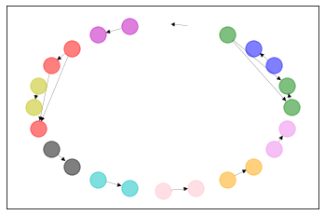
LOWLY ABUNDANT PLANT NETWORK
LABELS | VALUES
EDGE DENSITY | 0.02717391304347826
AVERAGE DEGREE DENSITY | 1.25
AVERAGE CLUSTERING COEFFIECIENT | 0.125
NO. OF COMMUNITIES | 11
COMMUNITIES | ['Alternanthera sp.', 'Amphibromus fluitans', 'Amphibromus nervosus’] ['Arthropodium minus', 'Arthropodium sp. 3 (aff. Strictum)', 'Bothriochloa macra'] ['Asperula conferta', 'Brassicaceae’] ['Amsinckia intermedia', 'Austrostipa scabra subsp falcata’] ['Amyema pendula subsp. pendula', 'Aster subulatus’] ['Avena barbata', 'Avena fatua'] ['Abutilon sp.', 'Boerhavia dominii’] ['Alternanthera sp A', 'Atriplex semibaccata’] ['Amyema miquelii', 'Amyema pendula’] ['Arctotheca calendula', 'Arrhenatherum elatius ‘] ['Acacia stenophylla', 'Austrostipa nodosa']

Slide 41
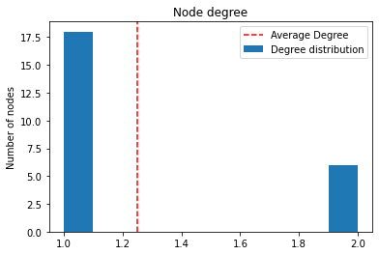
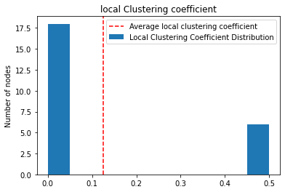
Degree distribution
Local clustering coefficient distribution

Slide 42
Thank you

